Slide 1
DS 5110 - Big Data Systems
Team 11: Casey Nguyen, Alex Kendrick, Grant Hanley

Slide 2
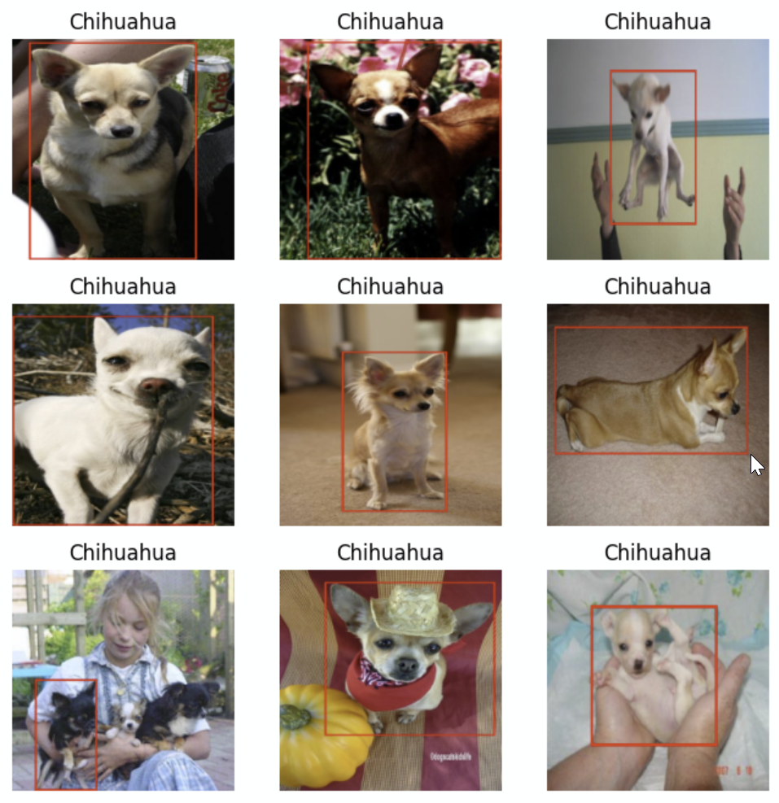
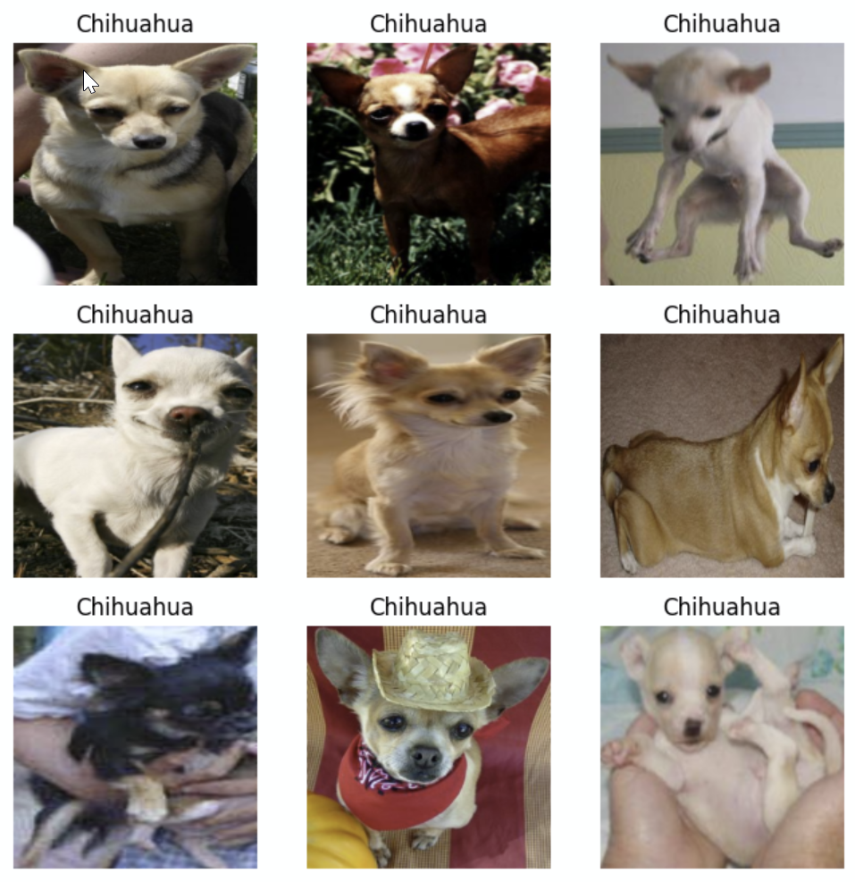
The Dataset
Stanford Dogs dataset:
The dataset is a subset of imagenet. Stanford dogs contains curated images for 120 breeds of dogs from around the world. It was originally curated using images and annotation from ImageNet for the task of fine-grained image categorization.
- 120 classes (different breeds of dogs)
- 20,580 images (jpg)
- Annotations: Class labels, Bounding box (xml)
- Variable image sizes and class sizes
- Little inter-class variation
https://people.csail.mit.edu/khosla/papers/fgvc2011.pdf
http://vision.stanford.edu/aditya86/ImageNetDogs/
Notes:
http://vision.stanford.edu/aditya86/ImageNetDogs/
https://people.csail.mit.edu/khosla/papers/fgvc2011.pdf

Slide 3
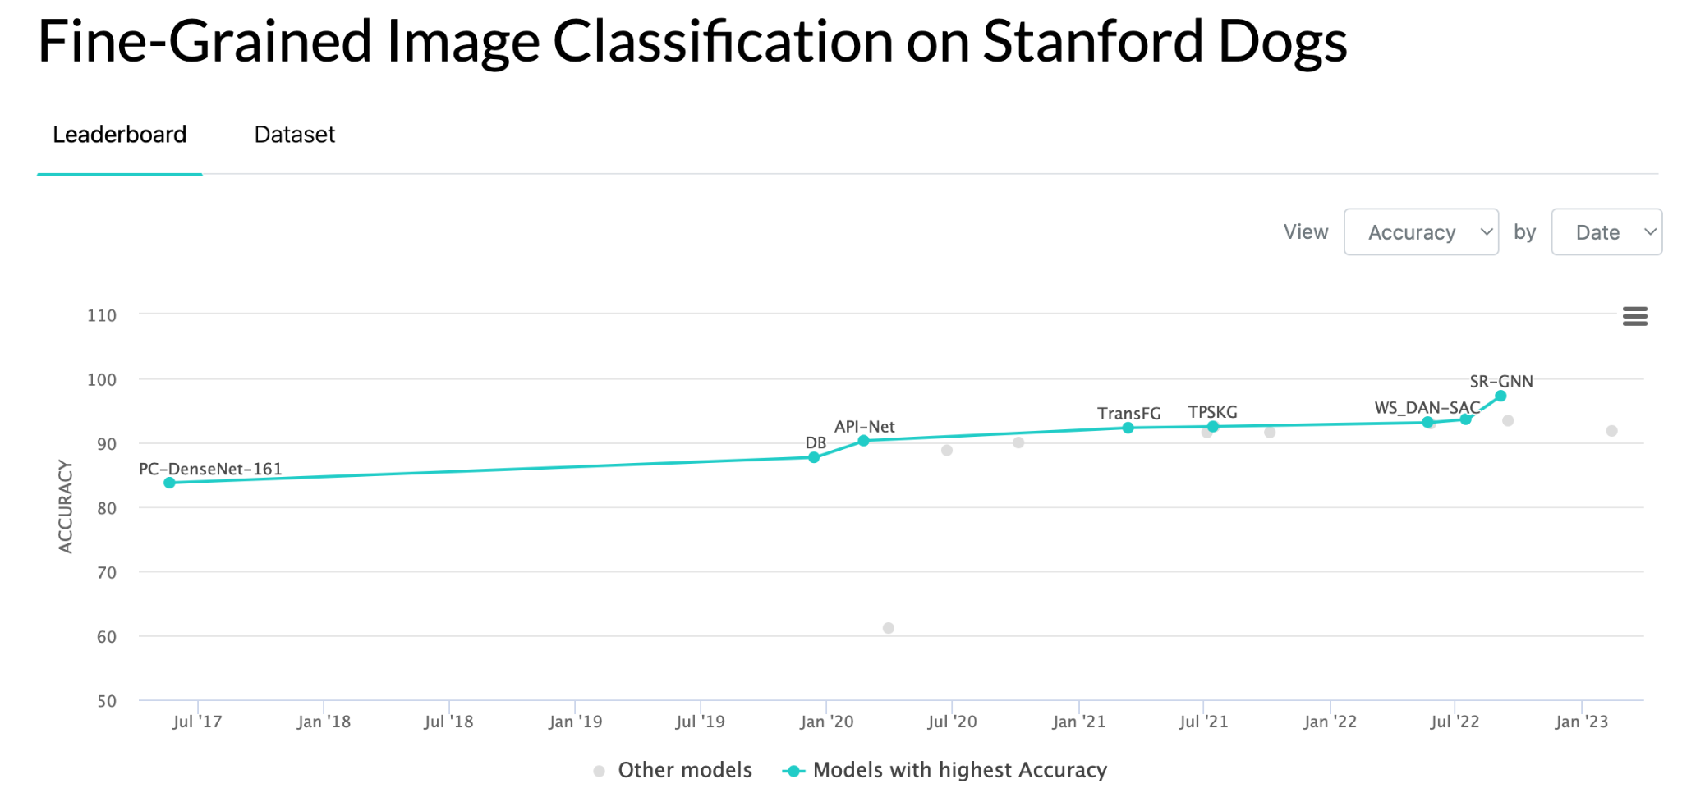
Problem Statement
We seek to benchmark some of the lightest weight models that are readily available on PyTorch without the expectation of achieving exceptional performance.
- Relatively lightweight dataset for frameworking AWS integration
- Mitigate business barriers to modeling success through cost reduction in development
- Reuse pretrained models
- Reduce cost, and training time with performance to enable parameter tuning

Slide 4




AWS Integration
We considered two setups for integrating AWS into a data science workflow.
1. An S3 bucket and an EC2 Instance
Runtime cost minimizing
Scales with instance selection
Linux / CLI development space
Collaboration is more challenging
Potential for auto-scaling
Potential for hosting
Production preferred
2. An S3 bucket and a Sagemaker instance
Scales with instance selection
Preconfigured Code Editor with VS Code like workspace
Collaboration works within an account
Development preferred

Slide 5
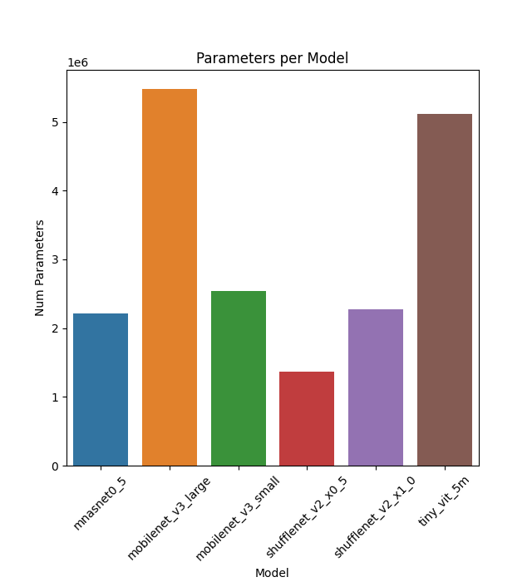
Models Evaluated
Model | # Parameters | Size (MB)
mnasnet0_5 | 2,218,512 | 8.87
mobilenet_v3_large | 5,483,032 | 21.93
mobilenet_v3_small | 2,542,856 | 10.17
shufflenetv2_x0_5 | 1,366,792 | 5.47
shufflenet_v2_x1_0 | 2,278,604 | 9.11
tiny_vit_5m | 5,110,284 | 20.44

Slide 6
Demo

Slide 7
The Way Ahead / Timeline
Project identification - 2/28
Github setup - 3/5
Data into course S3 - 3/7
Leverage Data Science with AWS notebooks and Boto3 for S3-Sagemaker connection - 3/9
Preprocessing labels reference file - 3/9
Custom PyTorch Dataset class - 3/10
Midterm Review - 3/12
Pre-trained model fine-tuning loading - 3/22
Model training - 4/01
Measure accuracy and training time - 4/01
Push tuned model(s) to S3 - 4/01

Slide 8
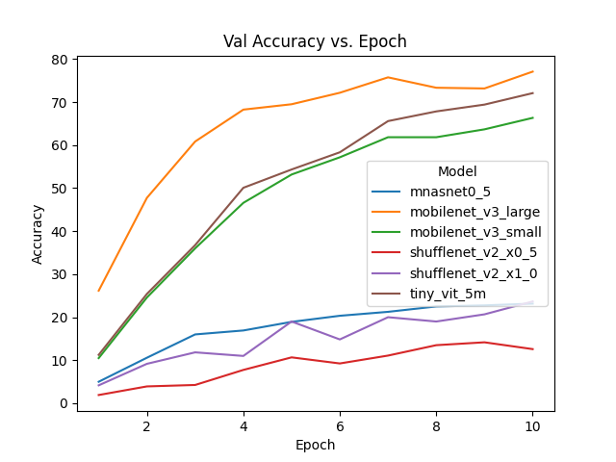
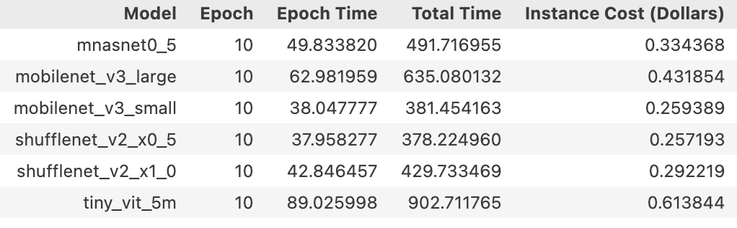
Results and Conclusion
Performance
Cost

Slide 9
Future Opportunities
Measure performance for __getitem__ upfront complete load vs batch from S3
integrate a save local on load to enable cache access
Tune Hyperparameters for each model
Try to bring up accuracy for smaller models
Learning rate scheduler
Explore different datasets
Explore further image augmentation
Explore image resizing impacts
Help prevent overfitting for all models

Slide 10
